Slide 1
CALIFORNIA PROBLEMS
STATE REQUIREMENTS /DRIVERS EDUCATION

Slide 2
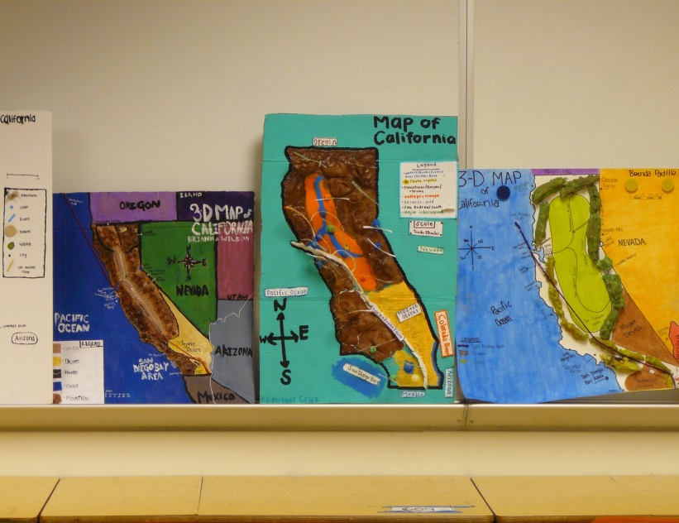
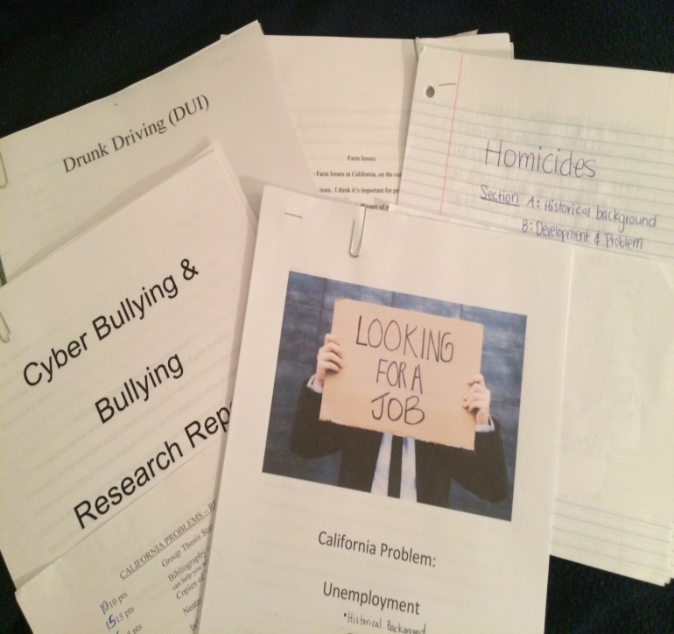
…A Project based class

Slide 4
California Problems is for the regular student who knows that s/he wants to start now for preparing to enter college.

Slide 5
California Problems is a college preparatory “A – G”
Class. You must have a certain number of college prep classes to get into top colleges

Slide 6
In California Problems
Primary
Sources &
Document Based Questions (DBQ’s)
are used

Slide 7
Primary Sources
DBQ’s
Project Based Units
ALL PREPARE YOU FOR FUTURE “AP” COURSES, STATE TESTING, & OTHER CLASSES AT MPHS

Slide 8
We also use the: San Jose Mercury News

Slide 9
...FOR CURRENT NEWS & EVENTS

Slide 10
1st Semester:
CALIFORNIA PROBLEMS
Students who enjoy history, current events & political discussions will do best in this class!

Slide 11
2nd Semester:
State Requirements (Health) & Driver’s Education

Slide 12
2nd Semester is all about YOU

Slide 13
Health: Addiction Units (Tobacco, Alcohol, Drugs), Nutrition, First Aid, Family Life Education
This is a great class for people interested in a health career: Doctor, Nurse, EMT, X-ray Tech, Medical Asst., Blood & Lab Work, Counselor, Pharmacists, Etc.

Slide 14
California PROblems/ state requirements & driver’s ed is the only class at MPHS where you can complete driver’s Ed during the regular school day!

Slide 15
Complete your 30 hours of Driver’s Education &
Get credit toward
graduation!

Slide 16
california problems/ State Requirements/ Driver’s Ed is a well-rounded & fun way to start your education at MPHS!

